Slide 1
The Learning Platform
The Team
Workshop Perspective
Introduction to Predictive Maintenance
The XGBoost Algorithm
Methodology
Model Accuracy
AGENDA

Slide 2
WORKSHOP perspective

Slide 3
WORKSHOP SUMMARY
Full-day, 8-hour workshop consisting of three hands-on labs
Applications of different types of deep learning models across data collection, curation, and formatting, based on a real production dataset (Backblaze hard disk DB)
The project covers a variety of methods/algorithms from Tree-based Machine Learning approaches to Deep Learning models.
You’ll learn how to deal with false/true positives in industrial applications by utilizing different methods such as timeseries prediction and anomaly detection.

Slide 4
WORKSHOP OUTLINE
1
LAB 1 (2 hrs)
Training GPU XGBoost models with RAPIDS for Time Series
2
LAB 2 (2 hrs)
Training GPU LSTM models using Keras + Tensorflow for Time Series
3
LAB 3 (2 hrs)
Training Autoencoder for Anomaly Detection
4
LAB 4 (2 hrs)
Hyperparameter Optimization
Notes:
Instructor: Read all bullet points in order

Slide 5
TARGET AUDIENCE
Industrial Engineers and Data Scientists who:
Work or research at industrial/manufacturing firms, or act as systems integrators
Have a technical background with limited deep learning experience
Are responsible for implementing high-performance solutions and efficient deep learning models

Slide 6
PREREQUISITES
Intermediate-level course requiring:
Experience with programming paradigms using Python
Basic understanding of data processing and deep learning (highly recommend completing the Fundamentals of Multi Data Types with NVIDIA DLI)
Participant works (or intends to work) in the industrial/manufacturing vertical and will be applying deep learning to their work

Slide 7
Introduction To Predictive Maintenance

Slide 8
PREDICTIVE MAINTENANCE
Schedule-based maintenance provides a regularly scheduled time for part replacements and repairs. A superior approach is predictive maintenance part replacements are driven by data and analytics.
Predictive maintenance can be divided into several key steps : a) identification of anomalies, b) estimation of remaining useful life of critical parts, c) mapping of anomalies to part failures through service logs. e logs.
Predictive maintenance helps to manage failures and avoid costly unplanned downtime.
Other benefits include fewer unnecessary repairs, optimized spare parts inventory, and longer lifespan of equipment and parts—ultimately increasing equipment availability and improving operational efficiency.

Slide 9

Oil field Predictive Maintenance
60K Oil Wells WW equipped with Electric Submersible Pumps (ESP)
Average Non Producing Time (NPT) due to ESP Failure costs > $150K per day per well
ML techniques used historically (Rule based, Fuzzy logic, traditional ML), but they don’t scale
>50% False Alarms + detect failures too late
Deep Learning: 93% detection accuracy with 2 months lead time at 7% False Alarm (for 200 wells)
At 10% False Positive, DL-based Anomaly Detection yields $300K per well of lost productivity annually
Notes:
200 well data obtained over 2 years, shows reduction in FA to 7% , detection accuracy of 97% with a lead time of 2 months.
150+ well data obtained over 2 years, shows DL techniques reduces the False Positive to <10% and achieves detection accuracy of 93% with a lead time of up to 2 months.
or cope well with the field variability (machine types, modes, age, environmental condition) and often results in > 50% False Alarms and poor anomaly detection, often too late to avoid NPT
21 days = $200 B WW 60K ESP wells. Average 2500 barrels/day/well $60 per barrel $ 9,000,000,000 per day ww production $ 150,000 per day per well $ 3,150,000

Slide 10
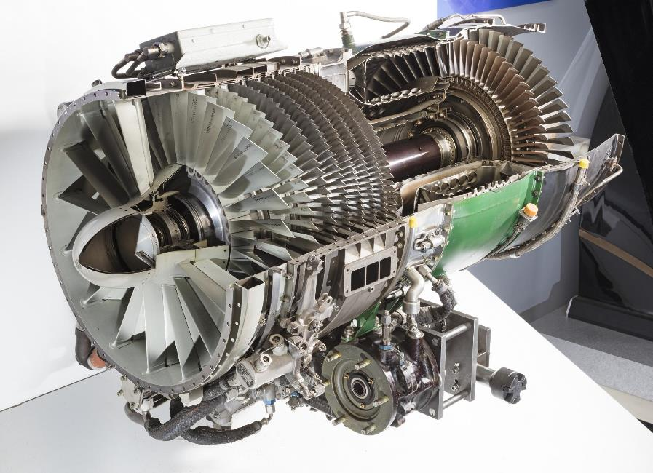
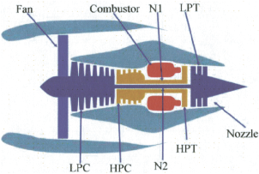


REMAINING USEFUL LIFE PREDICTION
Reliably predicting the remaining life of mechanical equipment avoids unscheduled maintenance and extends equipment utility.
The health of an engine fleet can be modeled using data from 21 engine sensors (temperature, pressure, rpm, etc.).
State of the art deep learning models are proving capable of predicting the remaining useful life with 35-49% better accuracy than traditional methods.
NASA engine dataset: Turbofan Engine Degradation Simulation Data Set https://ti.arc.nasa.gov/tech/dash/groups/pcoe/prognostic-data-repository/

Slide 11
WHAT DOES THIS WORKSHOP COVER?
Data collection, curation, augmentation, defining performance metric, training, inferencing, and iterating the whole pipeline to improve performance
Data curation covers processing raw dataset into panda’s data-frame, balancing heavily imbalanced dataset, data augmentation, and labeling introduction
Several Deep Learning model, e.g. : Autoencoders and LSTMS to tackle different aspect of data analysis
Directions on how to translate data into different categories of deep learning models. Learn how turn data in a classification problem vs. how to approach it from the anomaly detection point of view
How to use cuDF to increase performance of your models

Slide 12
workshop structure
LAB 1 (2 hrs.)
LAB 2 (2 hrs.)
Training GPU XGBoost models with RAPIDS for Time Series
Training GPU LSTM models using Keras+Tensorflow for Time Series
Discuss predictive maintenance, Blackblaze hard drive data, challenges of dealing with large noisy datasets.
Scope into short-term ML automation problem.
Ingest raw real dataset from GPU production line for XGBoost model.
Format DataFrames and into DMatrices to fit into model.
Analyze dataset statistics (i.e. false positives, true positives.)
Examine XGBoost performance over the model.
Learn how to balance imbalanced data and measure relevant KPIs to assess the model.
Discuss Recurrent Networks and Long Short-Term Memory (LSTMs).
Learn how to mitigate Vanishing Gradient Problem using LSTMs and get familiarized with their cell structure.
Learn how to create sequences of data to feed the temporal nature of RNNs.
Design different RNN architectures and even create your own model.
Learn how to create the confusion matrix and adjust the threshold to different f-1 scores.
LAB 3 (2 hrs.)
Training Autoencoder for Anomaly Detection
Focus on a different deep learning technique, which is called anomaly detection.
Learn how to use unsupervised learning algorithms like a deep autoencoder network to perform anomaly detection.
Learn how to create different autoencoder models in Keras.
General discussion on hyperparameter tuning and threshold settings.

Slide 13
XGBoost algorithm

Slide 14
WHAT IS XGBOOST
XGBoost stands for eXtreme Gradient Boosting
Widely known today as a "go to" model when working with structured data
Large number of XGBoost-based winning entries of Kaggle competitions
Based on tree ensemble methods such as Random Forests
XGBoost is used for supervised learning problems, where we use the training data (with multiple features) x to predict a target variable y
The actual mechanism is discussed next

Slide 15
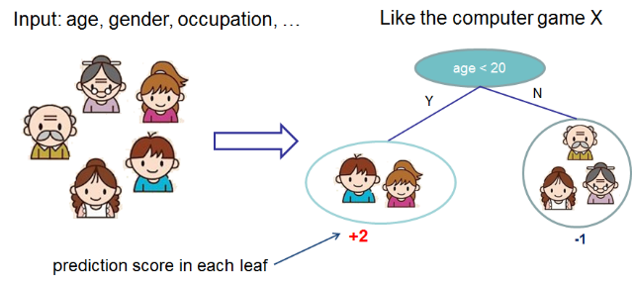
XGBoost – Classification trees
Decision trees
Image credit: XGBoost: A Scalable Tree Boosting System, T. Chen and C. Guestri

Slide 16
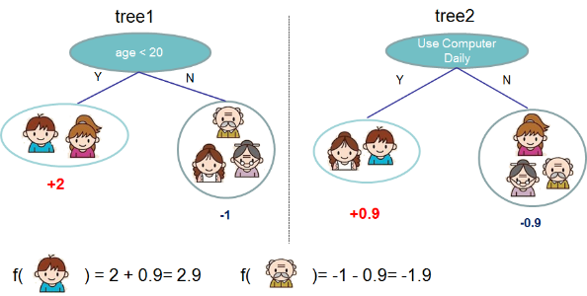
XGBoost – Classification trees
Decision tree ensembles
Tree ensemble of two trees. The prediction scores of each individual tree are summed up to get the final score
Image credit: XGBoost: A Scalable Tree Boosting System, T. Chen and C. Guestri

Slide 17
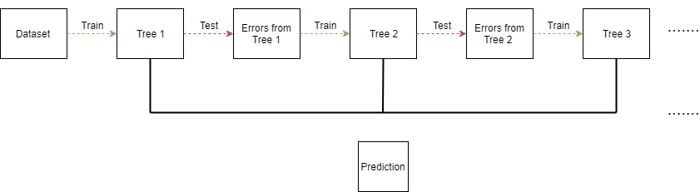
XGBoost – Classification trees
Decision trees
Repeatedly build new models and combine them into an ensemble. Unlike Random Forests, we build trees one at a time, where each new tree helps to correct errors made by previously trained tree

Slide 18
The Backblaze dataset

Slide 19
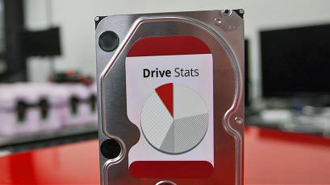
THE BACKBLAZE DATSET
“Each day in the Backblaze data center, a snapshot of each operational hard drive is taken. This snapshot includes basic drive information along with the S.M.A.R.T. statistics reported by that drive. The daily snapshot of one drive is one record or row of data. All of the drive snapshots for a given day are collected into a file consisting of a row for each active hard drive”
Image credit: Blackblaze website

Slide 20
THE BACKBLAZE DATA FORMAT
https://www.backblaze.com/b2/hard-drive-test-data.html
Date – The date of the file in yyyy-mm-dd format.
Serial Number – The manufacturer-assigned serial number of the drive.
Model – The manufacturer-assigned model number of the drive.
Capacity – The drive capacity in bytes.
Failure – Contains a “0” if the drive is OK. Contains a “1” if this is the last day the drive was operational before failing.
2015-2017 SMART Stats – 90 columns of data, that are the Raw and Normalized values for 45 different SMART stats as reported by the given drive. Each value is the number reported by the drive.

Slide 21
DATA PREPARATION THOUGHTS
https://www.backblaze.com/b2/hard-drive-test-data.html
Successful model creation is very dependent on data quality
Time Series sensor data is notoriously ‘jittery’ and has ‘holes’
While we walk through some of the preparation, for Lab 3, we filled in the holes to ensure similar time length sequences using a ‘Forward Fill’ technique

Slide 22
Methodology

Slide 23
Exercise
Train XGBoost on CPUs using Pandas’ DataFrame
Train XGBoost on GPUs using Pandas’ DataFrame
Train XGBoost on GPUs using RAPIDS’ cuDF

Slide 24
WHAT IS RAPIDS CUDF?
The RAPIDS suite of open source software libraries aim to enable execution of end-to-end data science and analytics pipelines entirely on GPUs. RAPIDS uses NVIDIA CUDA primitives for low-level compute optimization and is exposed to GPU parallelism and high-bandwidth memory speed through user-friendly Python interfaces.
Built based on the Apache Arrow columnar memory format, cuDF is a GPU DataFrame library for loading, joining, aggregating, filtering, and otherwise manipulating data. cuDF provides a pandas-like API that will be familiar to data engineers & data scientists, so they can use it to easily accelerate their workflows without going into the details of CUDA programming.

Slide 25
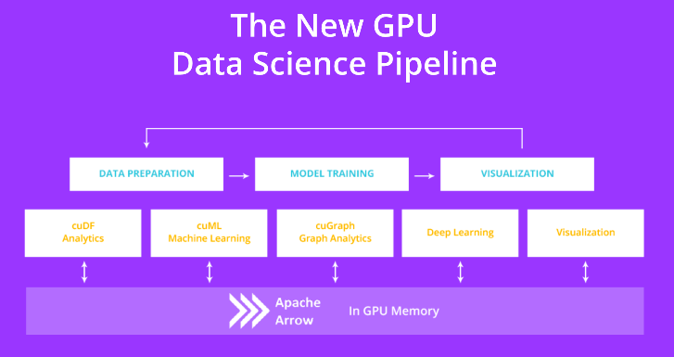
WHAT IS RAPIDS CUDF?

Slide 26
Model Accuracy

Slide 27
HOW TO MEASURE MODEL ACCURACY
Accuracy rate provides us with an overview of how well our model is performing:
True Positive (TP): test correctly classifies the input as its true class (hard drive failed, and we classified it as fail)
False Positive (FP): test incorrectly classifies the input as a different class (hard drive is normal, but we classified it as fail)
False Negative (FN): test incorrectly misses to classify the input as the true class (hard drive failed but we classified as normal)
True Negative (TN): test correctly misses to classify the input to the class (hard drive is normal, and we classified as normal)
We need more insights into the accuracy. Especially, since our dataset is imbalanced, and we need to compromise some aspects of accuracy rate in favor of others

Slide 28
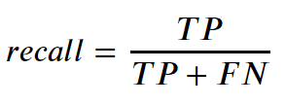
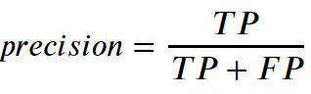
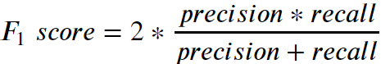
HOW TO MEASURE MODEL ACCURACY
Recall is the ability of the model to identify all true positive samples of the dataset
The ability of the model to identify the relevant samples only
F1 Score is generally considered a better overall measurement than accuracy when an uneven class distribution exists

Slide 29
STARTING the lab

Slide 30

LAB 1 MODEL SUMMARY
Goal: Train ML Model to classify hard drive as “normal” or “failed” based on current SMART features
Training: Use daily SMART features and “failed” label to train model to identify hard drives that we expect should have failed
Inference: Pass current SMART data from hard drive through model to infer whether we believe the drive should have failed or not
Day
Features (SMART Values for individual drive on 1 day)
Label
Features (Current SMART Values for hard drive)
…
01
02
03
04
…
18
19
20
21
N
01
02
03
04
18
19
20
21
FAILED
XGBoost Model
XGBoost Model
Failure Prediction
True / False

Slide 31
LAST THOUGHTS
Labs today will walk you through the standard workflows for Predictive Maintence use cases.
The accuracy you see won’t be optimal.
We are using a subset of the data – to speed up workflows.
We are using simpler models – to speed up workflows.
You will notice some delays in reading data and training – anywhere from 4 minutes to 10 minutes. We have added information messages to keep you aware.
There are a few “Exercises” where you are asked to fill in code. Look for “<<< TO DO >>>” markers. There is an answer available at the end of the task.

Slide 32
Summary

Slide 33
LAB 1 SUMMARY
Training GPU XGBoost models with RAPIDS for Time Series
Discuss predictive maintenance, Backblaze hard drive data, challenges of dealing with large noisy datasets.
Scope into short-term ML automation problem.
Ingest raw real dataset from GPU production line for XGBoost model.
Format DataFrames and into DMatrices to fit into model.
Analyze dataset statistics (i.e. false positives, true positives.)
Examine XGBoost performance over the model.
Learn how to balance imbalanced data and measure relevant KPIs to assess the model.

Slide 34
WHAT’S NEXT (LAB 2)?
Training GPU LSTM models using Keras + TensorFlow for Time Series
Discuss Recurrent Networks and Long Short-Term Memory (LSTMs).
Learn how to mitigate Vanishing Gradient Problem using LSTMs and get familiarized with their cell structure.
Learn how to create sequences of data to feed the temporal nature of RNNs.
Design different RNN architectures and even create your own model.
Learn how to create the confusion matrix and adjust the threshold to different f-1 scores.

